Slide 1
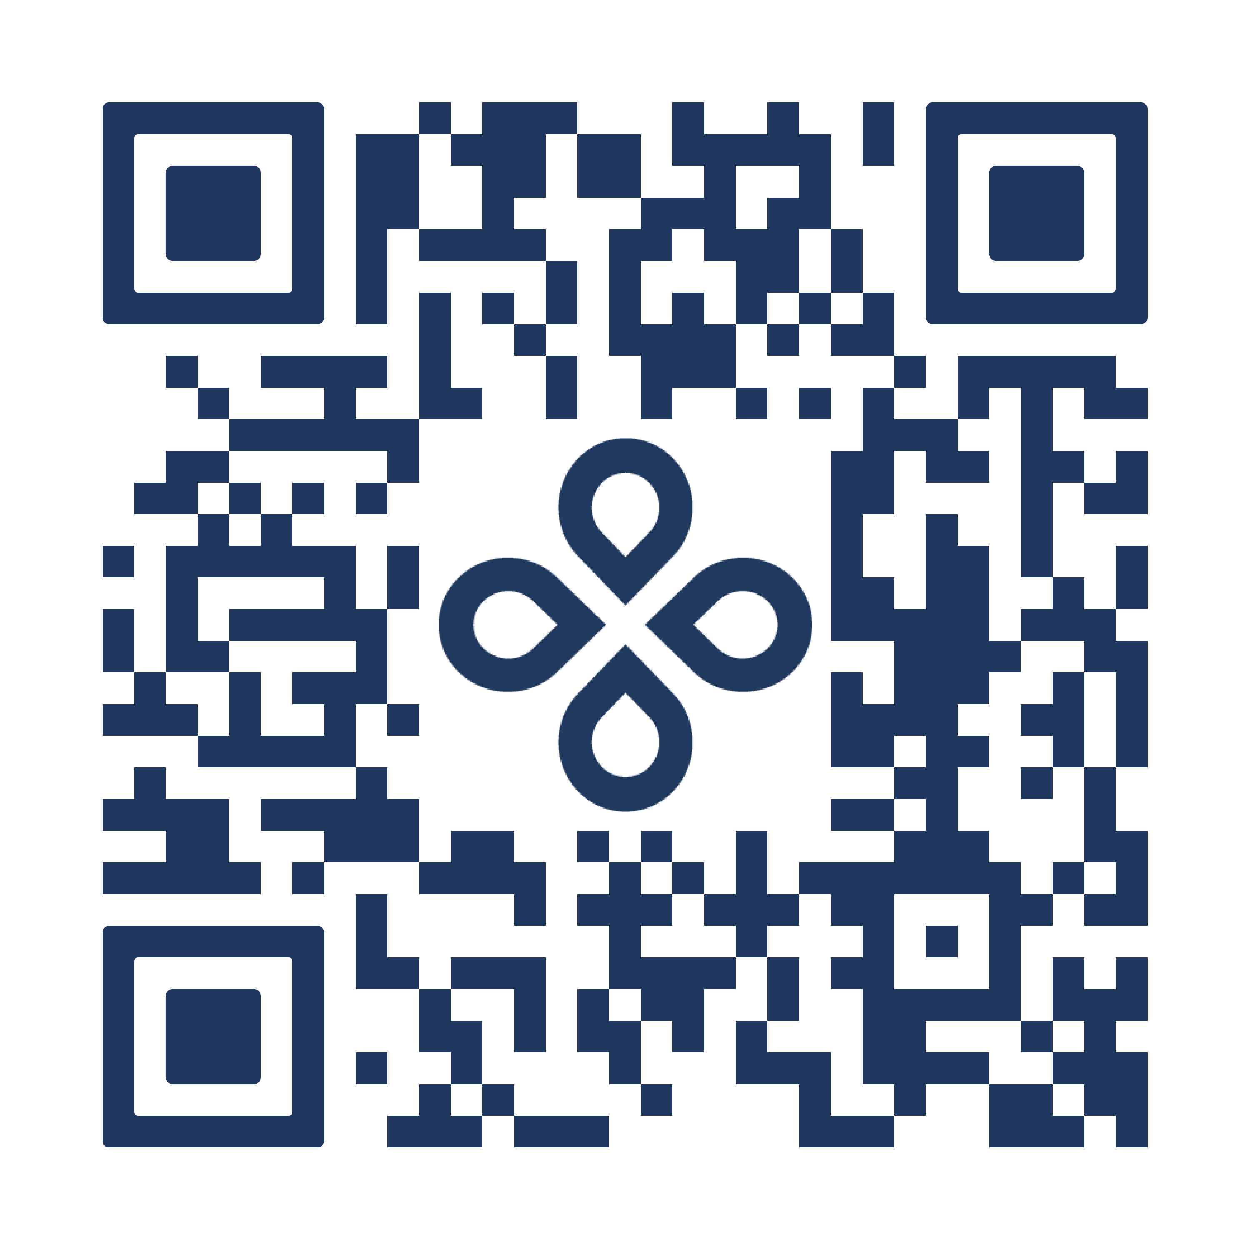
Scan to register:
Pregnancy & Postpartum 101 Webinar:
Supporting Maternal Mental Health
May 6th, 3 pm ET
Support starts
today:
Call xxx.xxx.xxxx
to get started
1:1 coaching for monthly guidance
Access to nurses & lactation consultants
On-demand digital resources
Postpartum recovery support
You must be You must be eligible through your organization to have access to the Progyny benefit.

