Slide 1
Communicating Your New Benefit: Pregnancy and Postpartum

Slide 2
Progyny’s Marketing and Communications Support
Your investment is bringing life-changing benefits to your employees and their families, and we are excited to help you highlight its value.
Consistent communication is key to ensuring benefit awareness and engagement. Use the resources in this toolkit to spread the word about your new Pregnancy and Postpartum program.
2
PROPRIETARY & CONFIDENTIAL | NOT FOR DISTRIBUTION

Slide 3
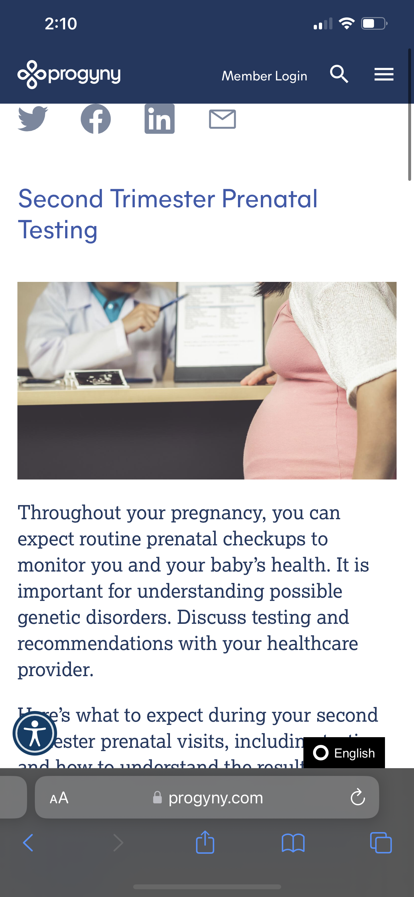
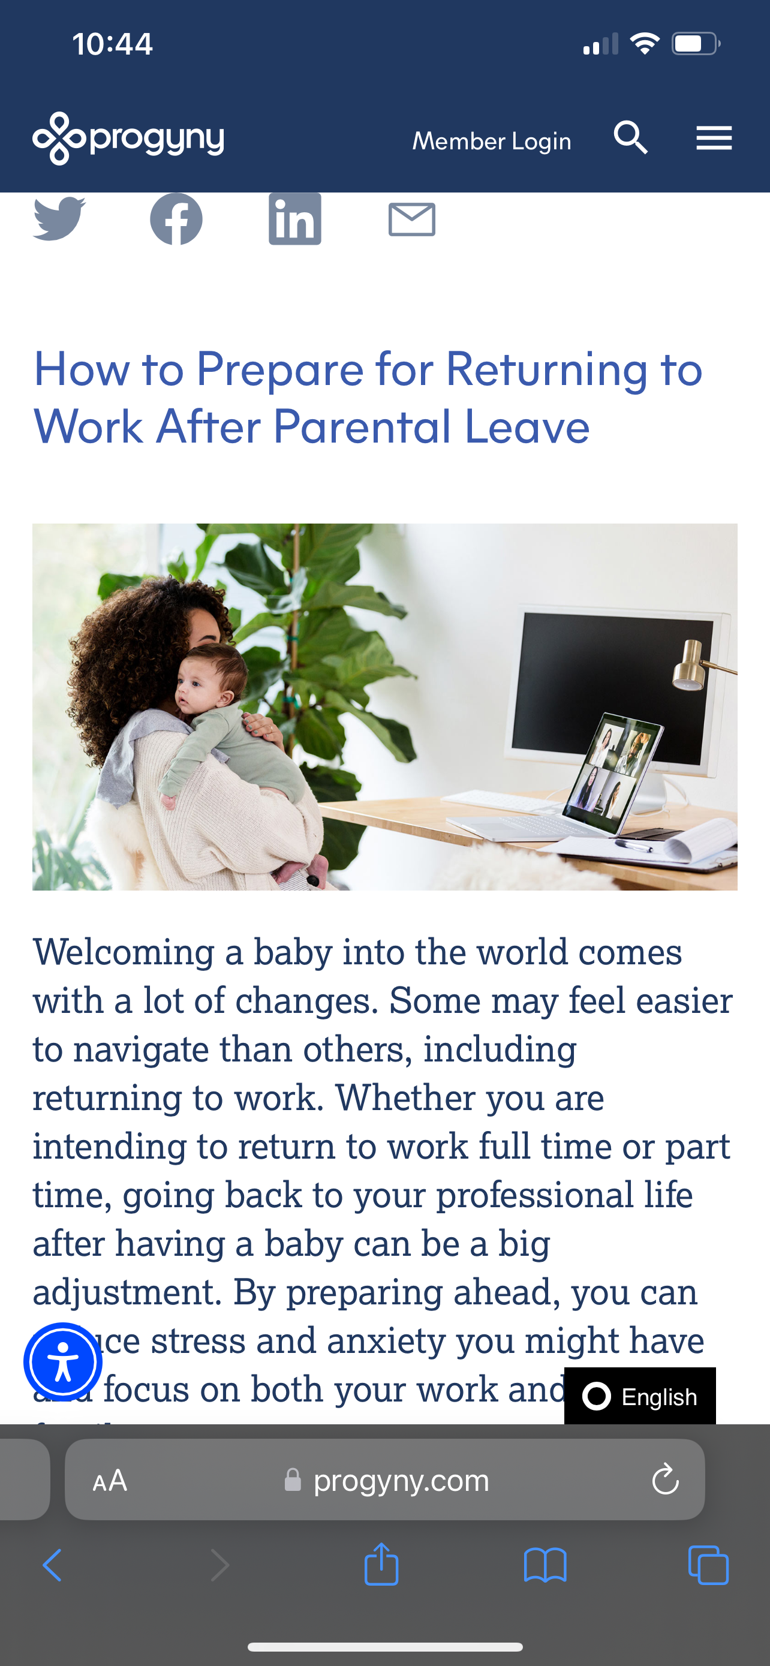
Pregnancy and Postpartum Support and guidance for a healthy pregnancy
Unlimited support: Pregnancy and Postpartum Coaches (experienced labor and delivery nurses and doulas) are your partners every step of the way
Designed by the experts: Clinical programming designed by women's health professionals such as OB/GYNs and Registered Nurses
Information at your fingertips: Your digital app includes tracking, education, and guidance to help you learn more about your pregnancy
Curated content: On-demand education to share different perspectives on parenthood
Progyny.com/education/pregnancy

Slide 4
Communicating Your New Benefit
Utilize these best practices to drive awareness and excitement before launch, once live, and throughout the year
Pre-launch
Send a benefit announcement email
Add information to intranet/benefits portal
If applicable, communicate transition of care with your population: Progyny can send an email and letter on your behalf
Go Live
Schedule a virtual or in-person educational event
Send postcard or other mailers
Share family friendly benefits on social media
Ongoing Benefit Education
Partner with parenting or family ERGs or affinity groups
Align benefit information to key communication themes or awareness periods (i.e., Maternal Health Awareness Day)
Progyny is happy to work with you to support custom communications.
Reach out to your Progyny contact to learn more.

Slide 5
Sample Benefit Communications Strategy
Utilize these recommended tactics to promote Progyny’s Pregnancy and Postpartum benefit across your population.
 | Month 1 (Launch) | Month 2 | Month 3 | Month 4 | Month 5 | Month 6
Intranet / Internal Benefits Hub | Spotlight on intranet/benefits portal within family, parenting, and women's sections, as well as within parental leave information |  |  |  | Highlight curated Progyny content for employee education (Progyny.com/education/pregnancy) | Align benefit information to key communication themes or awareness periods (i.e., Maternal Health Awareness Day, Women’s Health Week)
Emails & Newsletters (direct email, company newsletters) | Announcement email from Progyny to full population |  |  | Share all family-friendly benefits, including Progyny, to emphasize your support across all stages of life
Webinars & Virtual Events (full population, thematic, or specific ERGs) |  |  | Partner with parenting or family ERG/affinity group for a virtual or in-person educational event |  |  | Promote evergreen and/or upcoming Progyny-led member webinar(s)
Physical Distribution (postcards, mailers, posters) |  | Send postcards to households | Distribute onsite posters/flyers
External (social media, press, speaking engagements) |  | Highlight your investment on social media |  | Include Progyny benefits on your external job seekers site | Joint Company and Progyny social media post highlighting a member testimonial

Slide 6
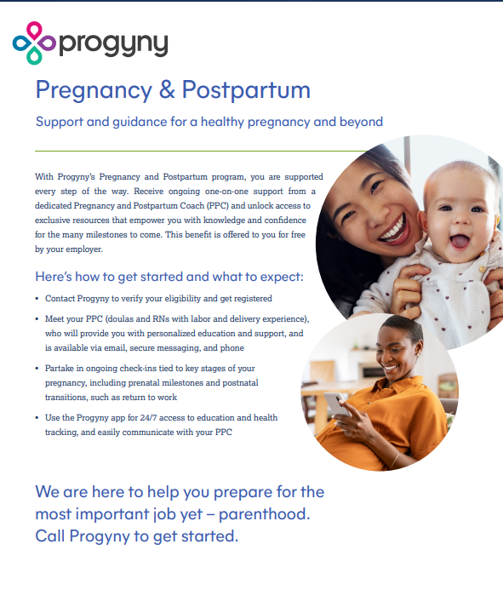
Member Materials
Please connect with your Progyny contact for cobranding and customization needs
What to Expect Handout
Sample Welcome Video
Frequently Asked Questions Handout
Banner Images

Slide 7
Sample Announcement Email
Use this content within an internal email to promote the new support available. Progyny can also send an announcement email on your behalf; please reach out to your Progyny contact for more information.
Subject: Introducing Progyny’s Pregnancy and Postpartum Support
Message: We are excited to offer a new pregnancy and postpartum program as part of the Progyny family of benefits. You will receive ongoing one-on-one support and unlock access to exclusive resources tied to each milestone to come. Beginning Phone Open Date, you can contact Progyny at Dedicated Progyny Phone Number for more information on getting started.
7
PROPRIETARY & CONFIDENTIAL | NOT FOR DISTRIBUTION

Slide 8
Sample Messaging for Internal Channels
Use this short-form messaging across internal channels (i.e., Intranet, messaging platforms) to drive awareness across employee population.
Hi team, exciting news. We have expanded our Progyny benefit to include support for healthy pregnancies and beyond. You are now eligible to enroll for Progyny’s Pregnancy and Postpartum program to receive ongoing one-on-one support and access to exclusive digital resources throughout your journey. Call Progyny Phone Number to get started.
Hi team, we are thrilled to announce a new pregnancy and postpartum benefit that is now available. As part of your Progyny benefit, expecting and new parents can enroll for one-on-one support and exclusive digital resources for ongoing guidance, education, and empowerment throughout your journey. Call Progyny Phone Number to get started.

Slide 9
Sample Social Media Posts
Use this language across social media channels to highlight your impactful commitment to employees, both inside and outside of the workplace.
We are proud to support and celebrate our employees during the moments that matter most. We are thrilled to offer Progyny’s Pregnancy and Postpartum program to provide guidance and support for healthy pregnancies and beyond.
Company has partnered with Progyny to offer support and guidance for healthy pregnancies and beyond. With this new Pregnancy and Postpartum program, we are proud to deliver best-in-class, one-on-one support for our employees' most important jobs yet – parenthood.
The moments that matter most to our employees matter to us, too. We are proud to support our expecting and new parents with Progyny’s Pregnancy and Postpartum program, providing ongoing guidance, education, and empowerment for the many milestones to come.

Slide 10
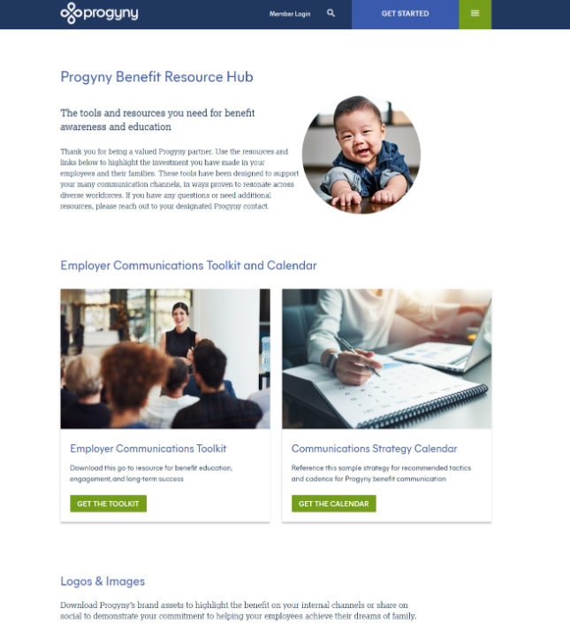
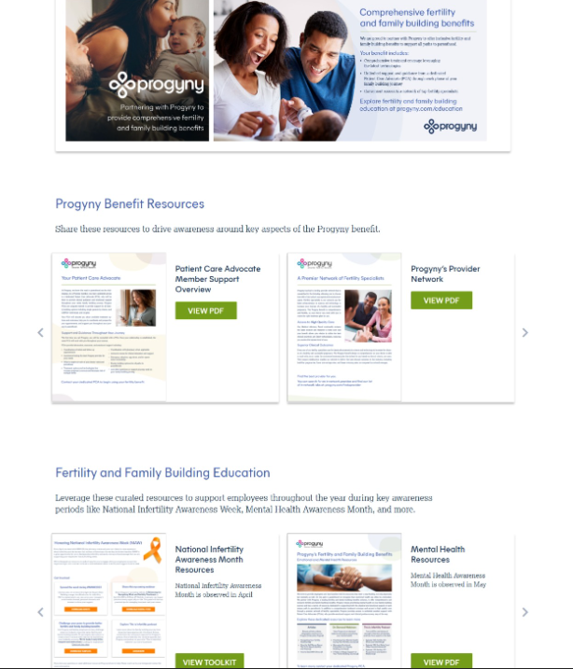
Progyny Brand Assets
Visit the Progyny Benefit Resource Hub to download Progyny brand assets for print and digital use.
Frequently Asked Questions Handout

Slide 11
Questions? We’re here to help. Reach out to your designated Progyny contact.

