Slide 1
Communicating Your New Benefit: Menopause and Midlife Care

Slide 2
Progyny’s Marketing and Communications Support
Progyny is proud to enhance our solutions to provide support during the moments that matter most. Your investment in this benefit is connecting employees to essential care and we are excited to help you highlight its value.
Consistent communication is key to ensuring employees understand the coverage options available, so we have designed this toolkit to make it easy to drive awareness for your new benefit.
2
PROPRIETARY & CONFIDENTIAL | NOT FOR DISTRIBUTION

Slide 3
Menopause and Midlife Care
Personalized, integrated care for every stage of menopause
Nationwide Network
Proactive Intervention
Integrative and Ongoing Care
of menopause-certified experts
dedicated advocacy and symptom management
targeted chronic condition support
Virtual access to OB/GYNS, NPs, registered dieticians, & mental health clinicians
Appointments available in days, not months
Tailored symptom relief to improve quality of life
Non-hormonal and hormone treatments
Lifestyle support for nutrition, weight, sleep and mood
Early screening for chronic conditions; cancer, cardiovascular, metabolic, and more
Mental health therapy and treatment

Slide 4
Communicating Your New Benefit
Utilize these best practices to drive awareness and excitement before launch, once live, and throughout the year
Go Live
Spotlight on intranet/benefits portal within women’s health and wellness-related sections
Send postcards to households to reach partners/spouse
Highlight your investment on social media
Ongoing Benefit Education
Schedule a virtual or in person educational event
Partner with ERGs or affinity groups
Align benefit information to key awareness periods (i.e., Women's Health Week, American Heart Month, Menopause Awareness Month)
Pre-launch
Send 'coming soon' announcement email
Highlight in open enrollment materials and/or benefit fairs

Slide 5
Sample Benefit Communications Strategy
Utilize these recommended tactics to promote Progyny’s Menopause and Midlife Care benefit across your population.
 | Month 1 (Launch) | Month 2 | Month 3 | Month 4 | Month 5 | Month 6
Intranet / Internal Benefits Hub | Spotlight on intranet/benefits portal within women’s health and wellness-related sections |  |  |  | Highlight curated Progyny content for employee education (Progyny.com/education/menopause) | Align benefit information to key communication themes or awareness periods (i.e. Women’s Health Week)
Emails & Newsletters (direct email, company newsletters) | Announcement email from Progyny to full population |  | Share all health and wellness benefits, including Progyny, to emphasize your commitment to optimizing employee well-being
Webinars & Virtual Events (full population, thematic, or specific ERGs) |  | Host an educational training for managers/benefit leaders to better understand menopause in the workplace |  | Partner with women’s ERG/affinity group for a virtual or in-person educational event |  | Promote evergreen and/or upcoming Progyny-led member webinar(s)
Physical Distribution (postcards, mailers, posters) |  | Send postcards to households to reach partners/spouses |  |  | Partner with women’s ERG/affinity group for a virtual or in-person educational event
External (social media, press, speaking engagements) |  |  | Highlight your investment on social media | Include Progyny benefits on your external job seekers site

Slide 6
Sample Announcement Email
Use this content within an internal email to promote the new support available. Progyny can also send an announcement email on your behalf; please reach out to your Progyny contact for more information.
Subject: Introducing New Menopause and Midlife Care Benefits With Progyny
Message: We are proud to partner with Progyny to offer menopause and midlife care - a new program offered as part of the Progyny family of benefits. You’ll be connected to integrative virtual care for personalized treatment plans, lifestyle support, and symptom relief. To get started and book your first visit, contact Progyny at Dedicated Progyny Phone Number.
6
PROPRIETARY & CONFIDENTIAL | NOT FOR DISTRIBUTION

Slide 7
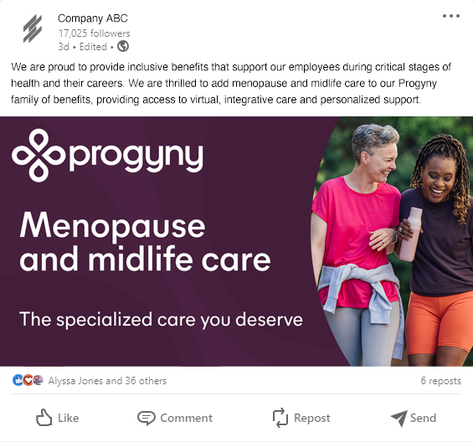
Sample Social Media Posts
Use this language on your social media channels to highlight your commitment to your employees at every stage of their career.
We are proud to provide inclusive benefits that support our employees during critical stages of health and their careers. We are thrilled to add menopause and midlife care to our Progyny family of benefits, providing access to virtual, integrative care and personalized support.
Company has partnered with Progyny to offer virtual care for all stages of menopause. Employees will have nationwide access to menopause experts, personalized treatment plans, and lifestyle support to manage their symptoms and improve overall health.
We provide comprehensive benefits that support our employees during the many transitions in life and are proud to partner with Progyny to add menopause and midlife care. Eligible employees will have access to experts for ongoing treatment and symptom relief.

Slide 8
Sample Messaging for Internal Channels
Use this short-form messaging across internal channels (i.e., intranet, messaging platforms) to promote this new benefit.
Hi team, we are thrilled to announce a new benefit through Progyny for menopause and midlife care. Eligible members now have nationwide access to specialized virtual care for all stages of menopause. Get the care you deserve, manage your symptoms, and boost overall health. Call Progyny Phone Number to get started and book your visit today.
Hi team, exciting news. We have expanded our Progyny benefit to include support for menopause and midlife care. You’ll have access to virtual, integrative care; hormonal and non-hormonal treatment; and lifestyle support for symptom relief. Call Progyny Phone Number to get started.
8
PROPRIETARY & CONFIDENTIAL | NOT FOR DISTRIBUTION

Slide 9
Member Materials
Please connect with your Progyny contact for cobranding and customization needs
What to Expect
Frequently Asked Questions
Postcard Mailer
Frequently Asked Questions Handout
Optional deliverable to eligible households.

Slide 10
Banner Images
Access images here and please connect with your Progyny contact for cobranding and customization
Frequently Asked Questions Handout

Slide 11
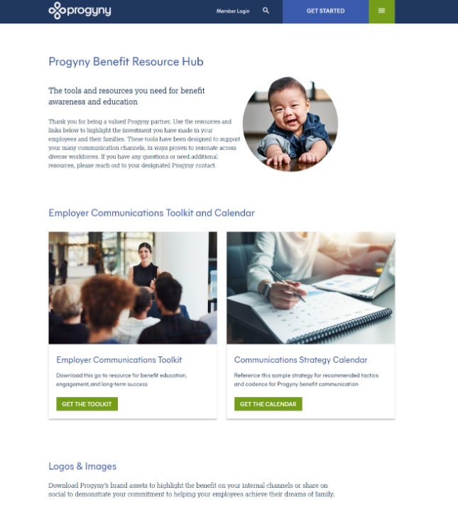
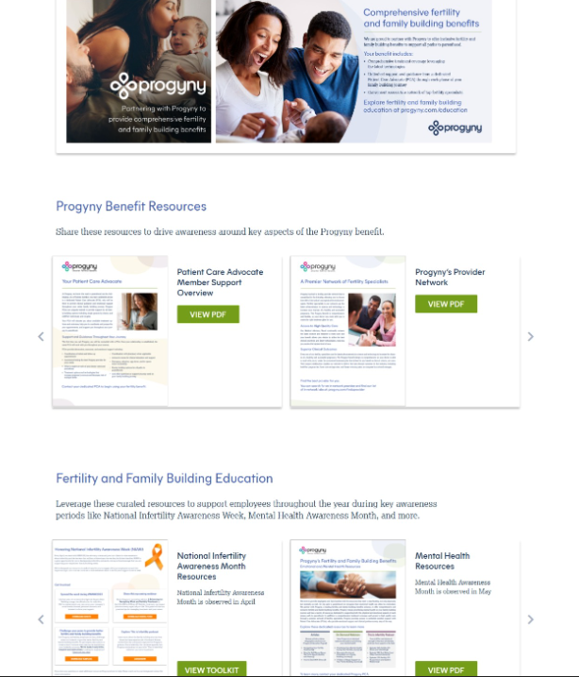
Progyny Brand Assets
Visit the Progyny Benefit Resource Hub to download Progyny brand assets for print and digital use
Frequently Asked Questions Handout

